Slide 1

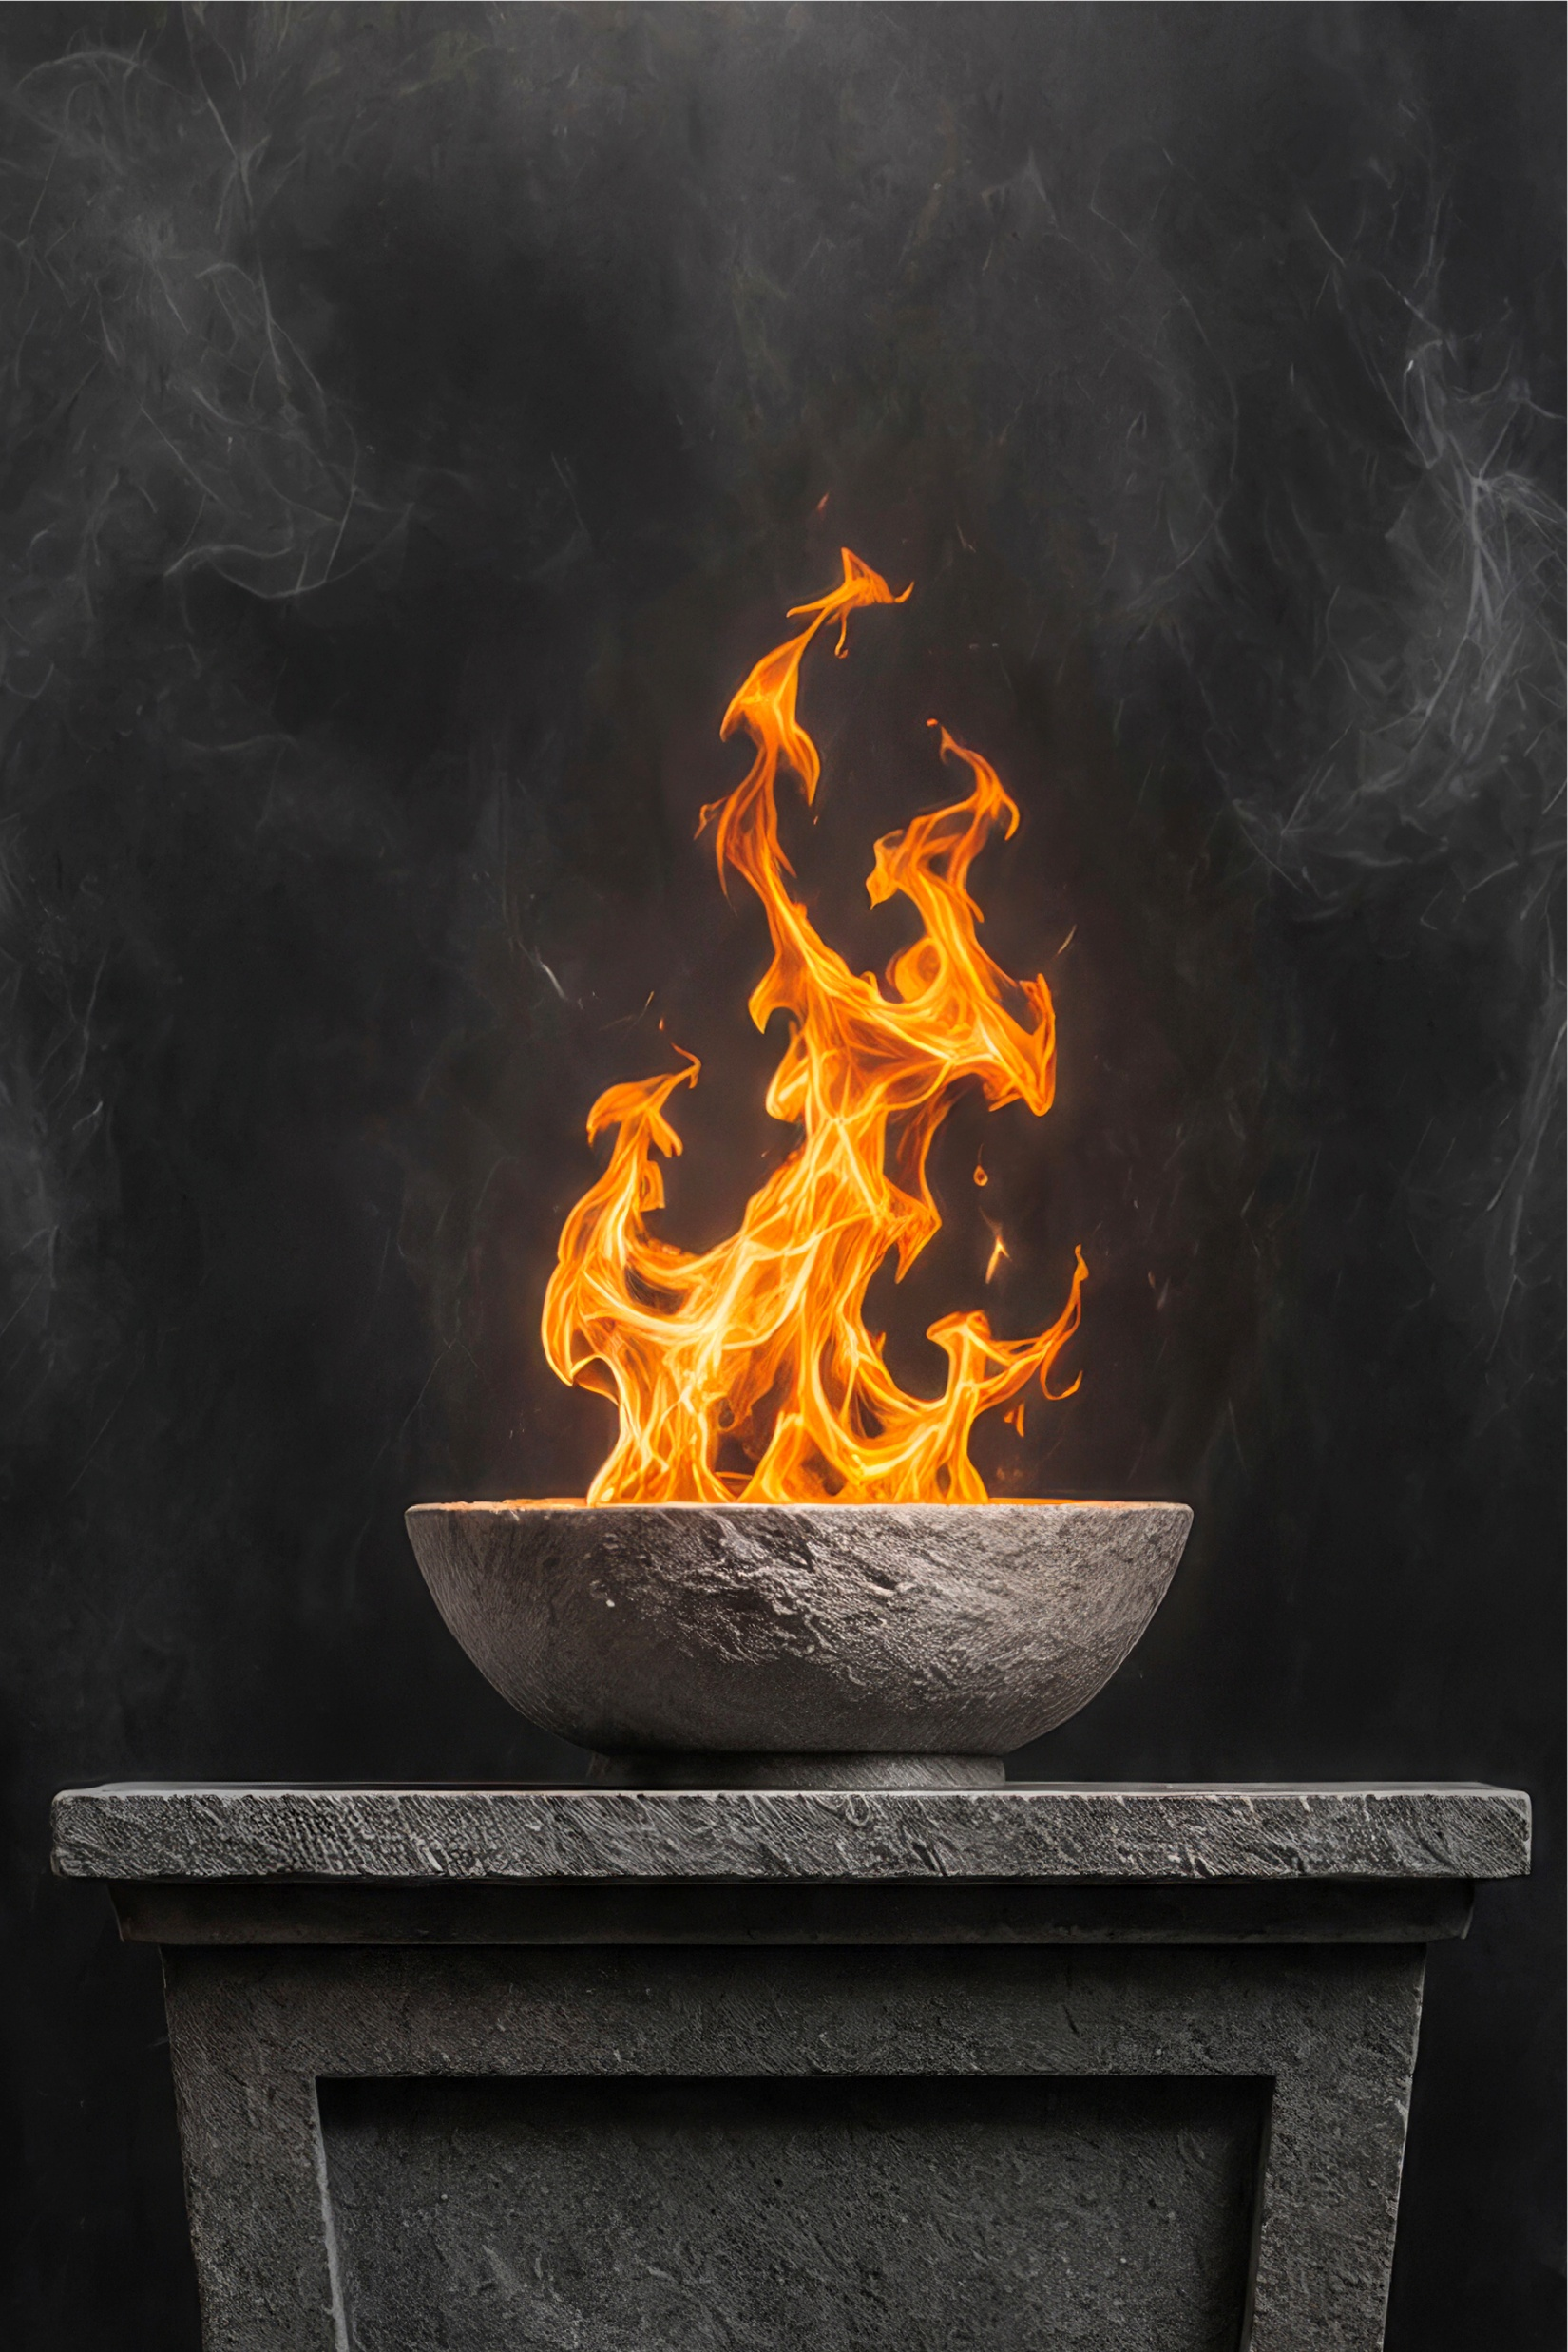

Historical Fiction
Altar Fires
Fear dogs Cullen Parsons like a shadow he can’t outrun. When it kills a priest he swore to protect, Cullen decides fear dies only when the men it destroys are avenged.
Altar Fires
From graduation to seminary to the Army, Cullen drifts through life searching for purpose and finding only dread. Seminary fails him. The Army breaks him. Serving as a chaplain’s assistant overseas gives him a glimpse of meaning—until Father Cahill is taken from him in a blast that shatters whatever sense of meaning remained. The guilt is merciless. It drives him into drink, into ruin, and finally into the hard discipline of ambulance work, where every call is a penance. When he meets a young woman barely clinging to life after an overdose, Cullen sees a chance to avenge Cahill by protecting her from the darkness that swallowed him. But fear is patient. It waits. And Cullen’s final stand against it may be the one battle he cannot win.
T.R. HEALY
T.R. HEALY

